Slide 1
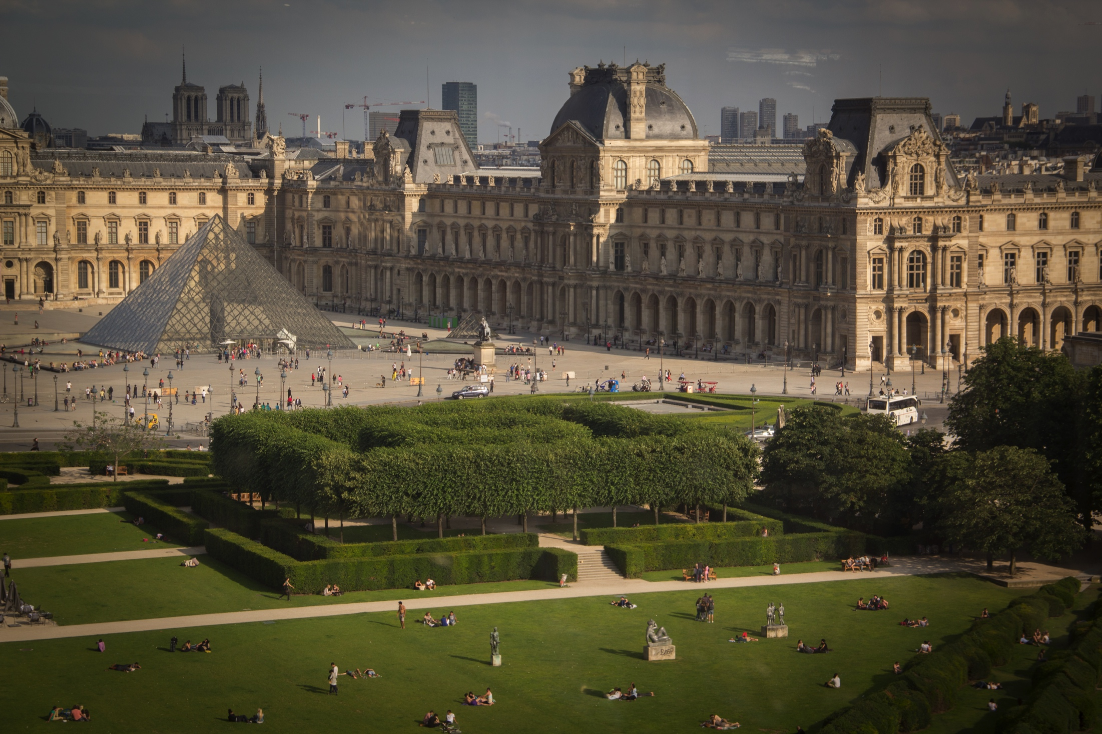
Art Museums:
The Institution of Art
By Sarah Fritz
Notes:
This template can be used as a starter file for a photo album.

Slide 2
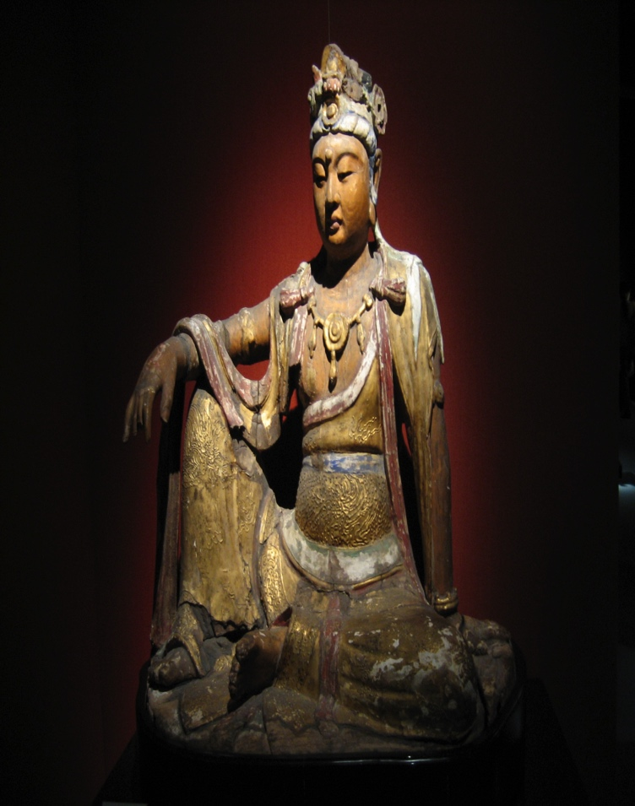
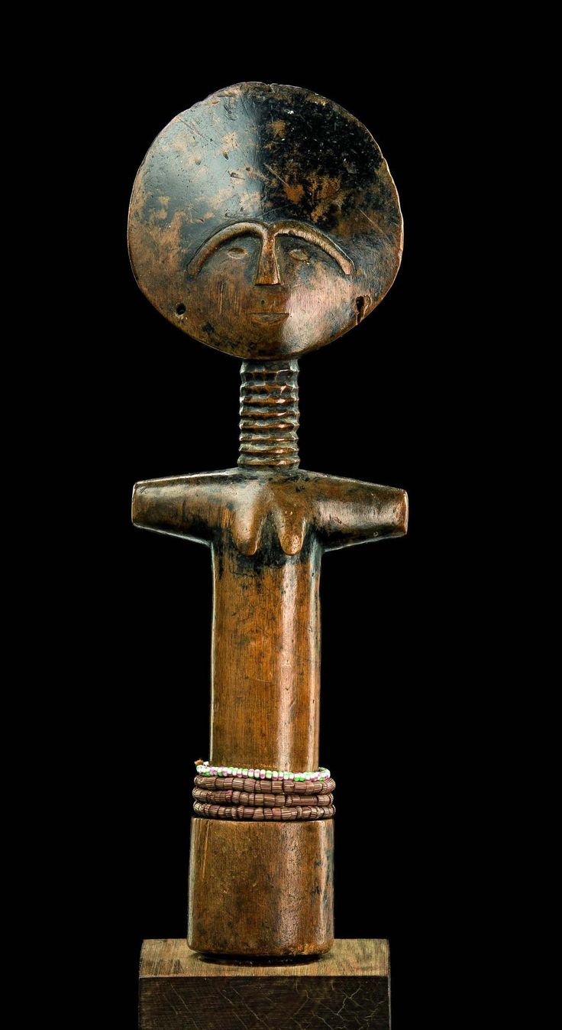
Humans have been creating art for thousands of years, long before museums existed…
Boddhistava
Fertility doll
Queen Neffertiti
How did society access art before the public museums ? Throughout civilization, much art has been created for either royalty or religion, and been controlled or managed by those patrons. Even among tribal societies, regalia or sacred objects were reserved for specific people and purposes.

Slide 3
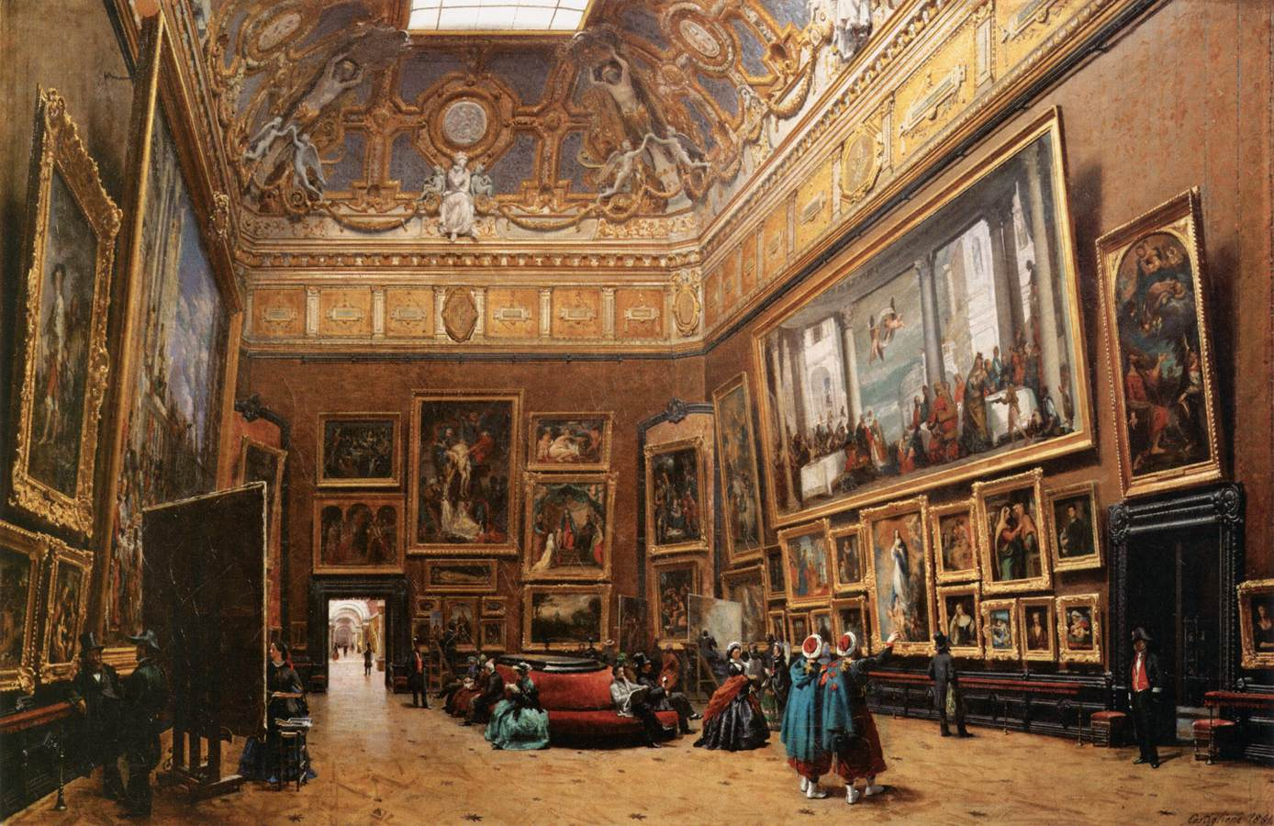
Public viewing of art
In Egypt and other early civilizations the art was in palaces, temples or tombs, and rarely seen by the masses. It wasn’t until after the Renaissance that the dam of creativity and intellectual exploration burst and there was so much material to share that it began to be loosely organized via wealthy patrons’ collections such as the Medici and Borghese families. Academies for painting began to be held in such places, and in the palaces of France they were known as salons. It was in this way that the context for the Louvre’ was born, though the Musei Capitolino in Rome could technically be the first museum.

Slide 4
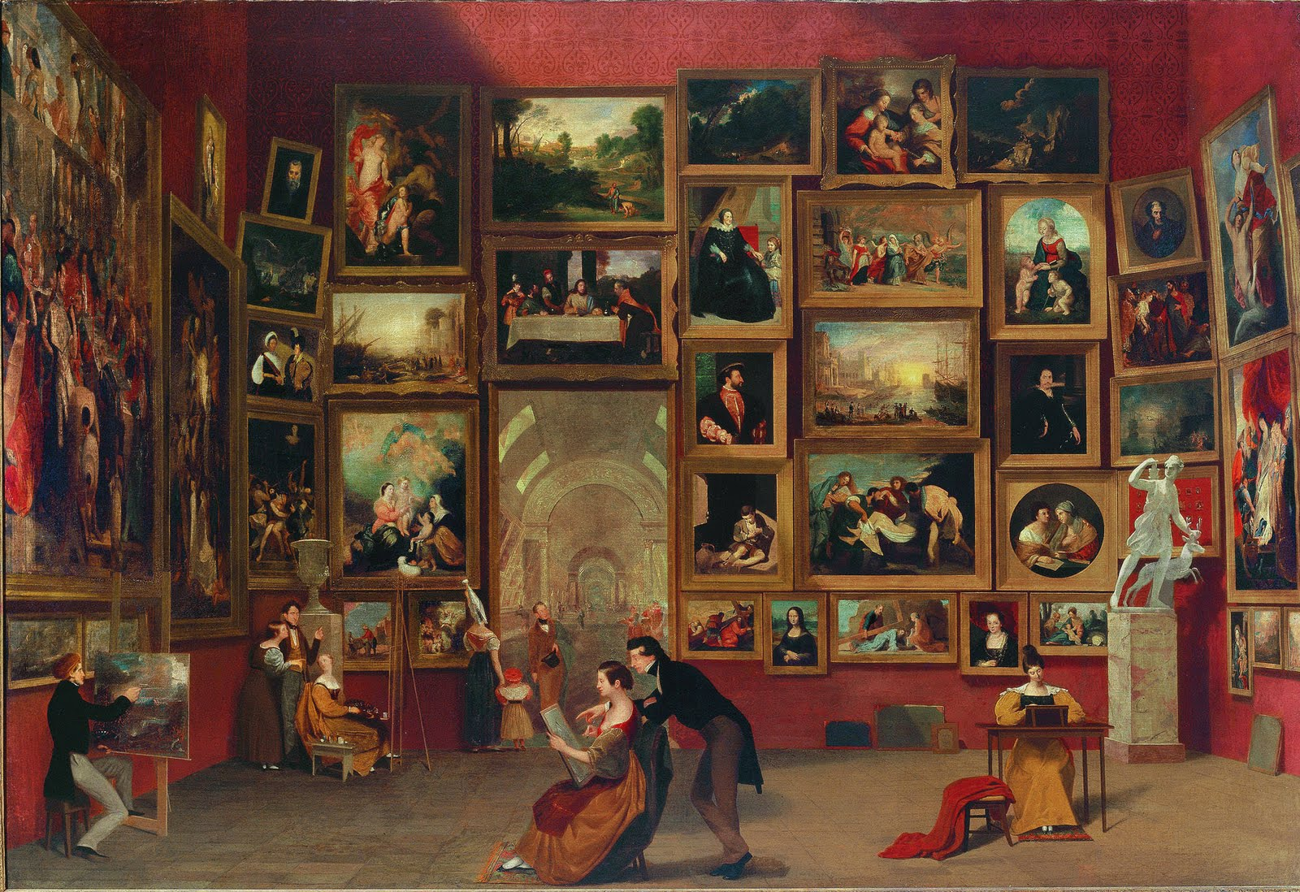
The Louvre is considered the first truly public museum, and it started with the palace collection of Louis XIV, the decadent Sun King. However, with the French revolution came the idea that it should be open to the public and represent national identity and pride, and so it has been ever since, creating a model for art institutions around the world.

Slide 5
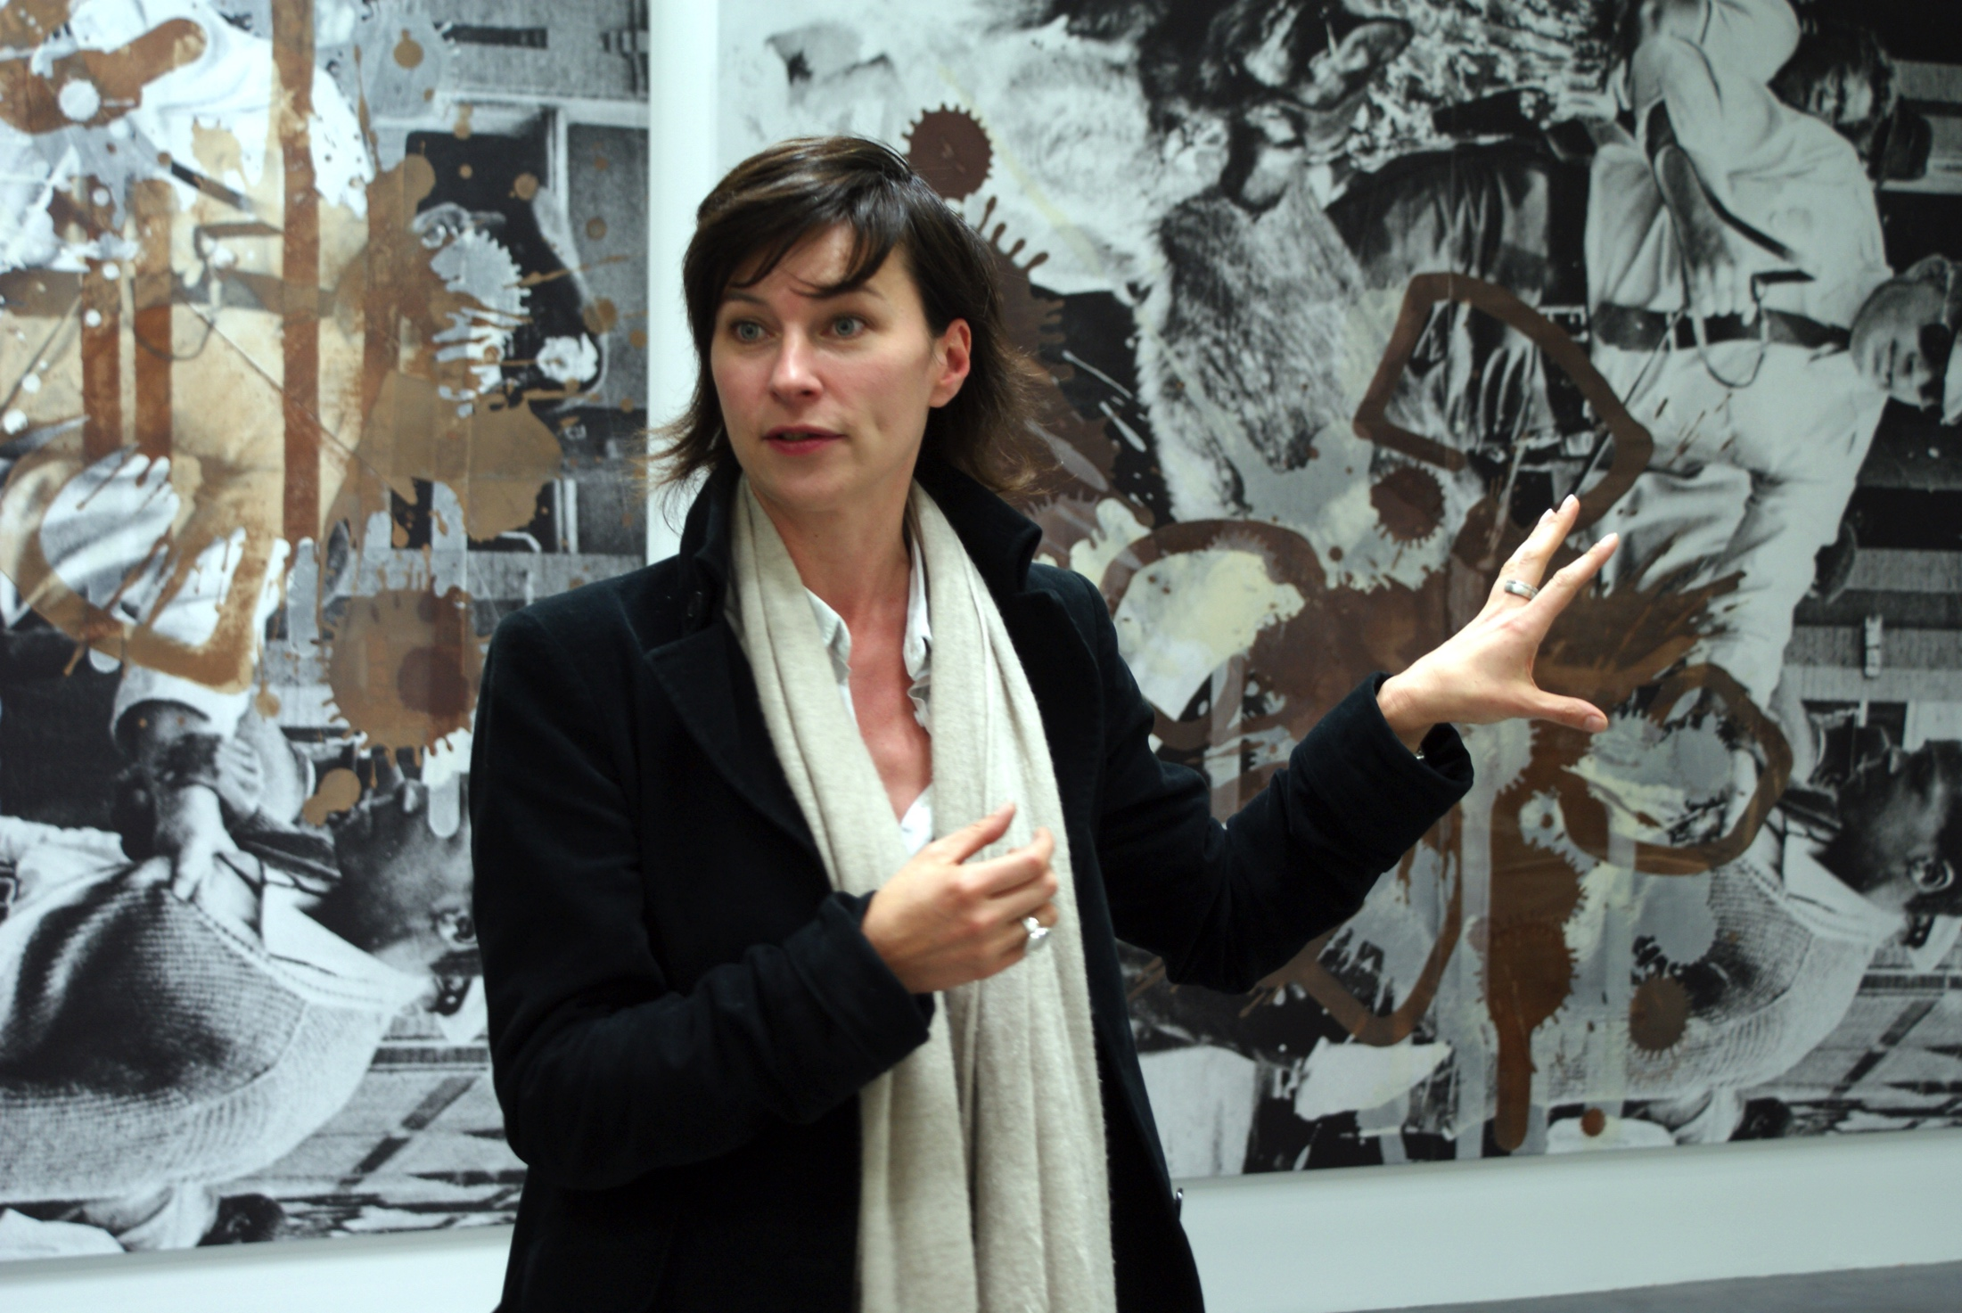
What is the purpose of the institution of art sociologically and what role does the public museum play in that? Who are the major players? The
and funders, the curators, and the viewers all have different perceptions and experiences, and come from different SES backgrounds.
Notes:
Who am I adding notes for? Myself or for the presentation?

Slide 6
THINK TANK
FOR CREATIVE EXPLORATION
EDUCATES PEOPLE ON ART AND ART HISTORY
ENCOURAGES ABSTRACT & CRITICAL THINKING
DEFINES ART & WHAT CONTITUTES A MASTERPIECE
TRANSMITS
CULTURE VISUALLY
EXPRESSES NATIONAL IDENTITY

Slide 7
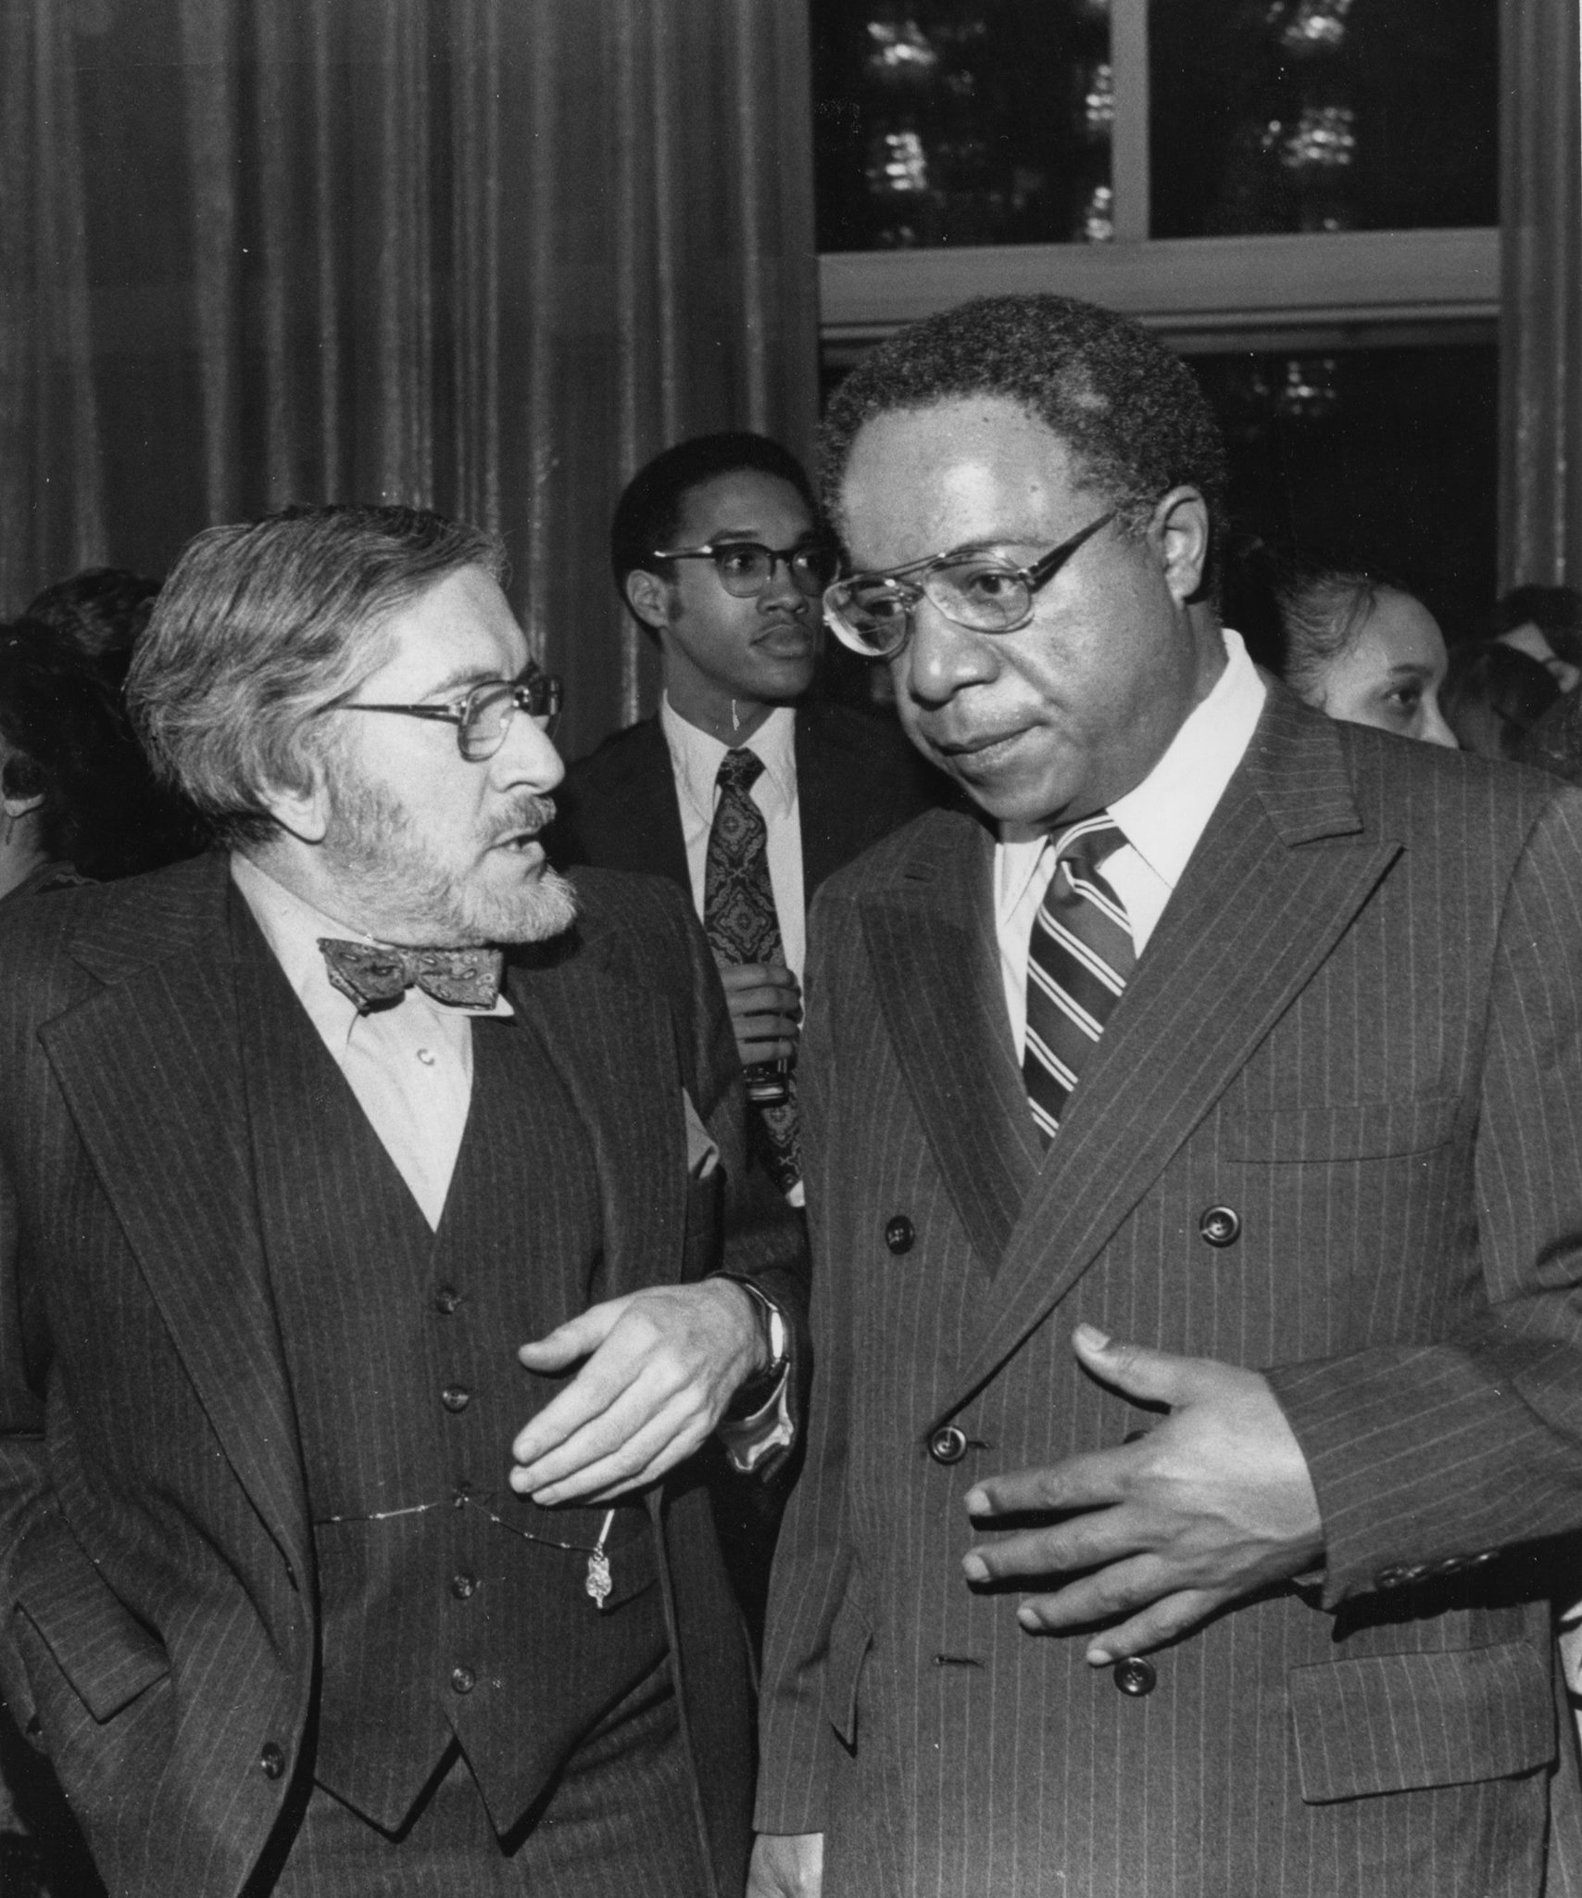
Functionalist
PARADIGM
From the functionalist perspective, it is clear how the institution of art and the role of museums and their staff has an important place in society. The intellectual and cultural definitions that come out of the art world shape how society interprets the world around them and their place in it. Like religion, it helps to funnel the human need to grasp spiritual mysteries, public art museums help society grasp the creative miracle. It also plays a part economically, as art has become a commodity for investment, and the art world helps to define worth.

Slide 8
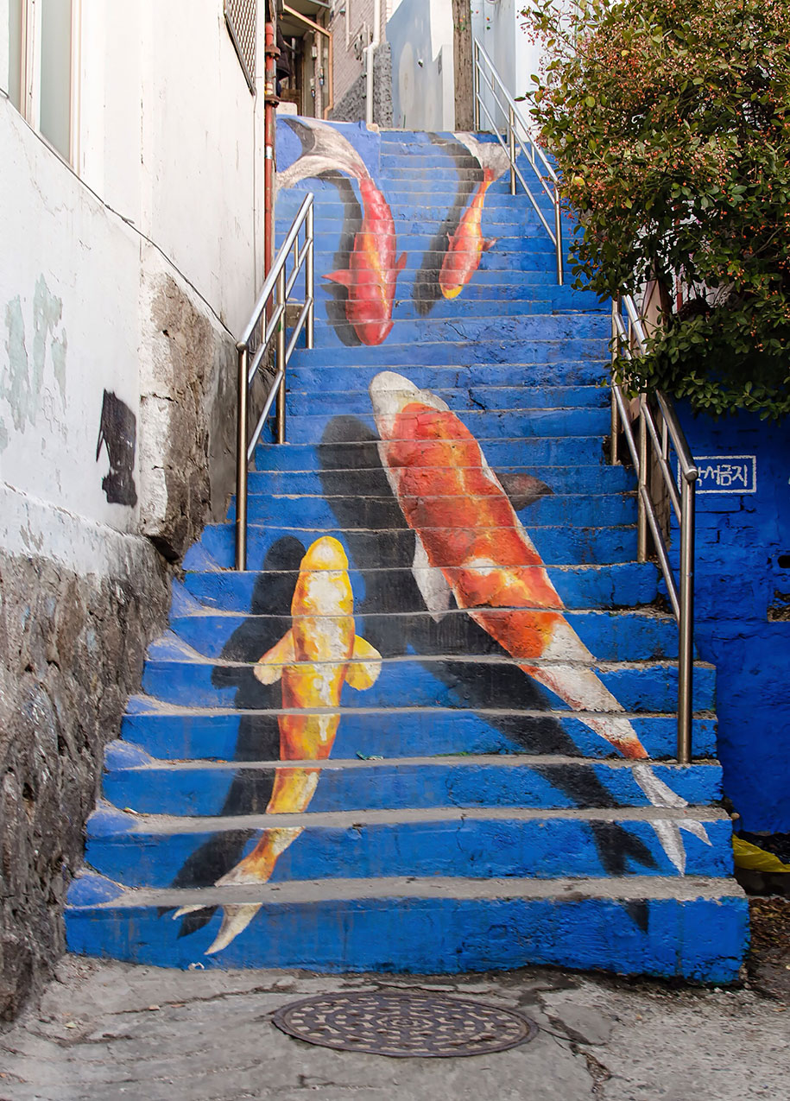
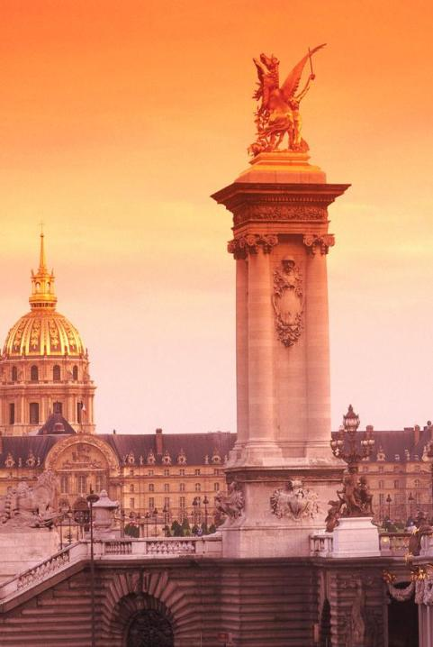
Unboxed: Art as a part of life
What about art that has always been but not in a museum? How is art different when it is experienced as a part of life, either daily or ritually?
Street art is seen by many as the real art for the public, accessible to the masses, readable and not over intellectualized for an elite group to consume. Street art, graffiti, murals and the like are not for sale, but stand for all eyes to see

Slide 10
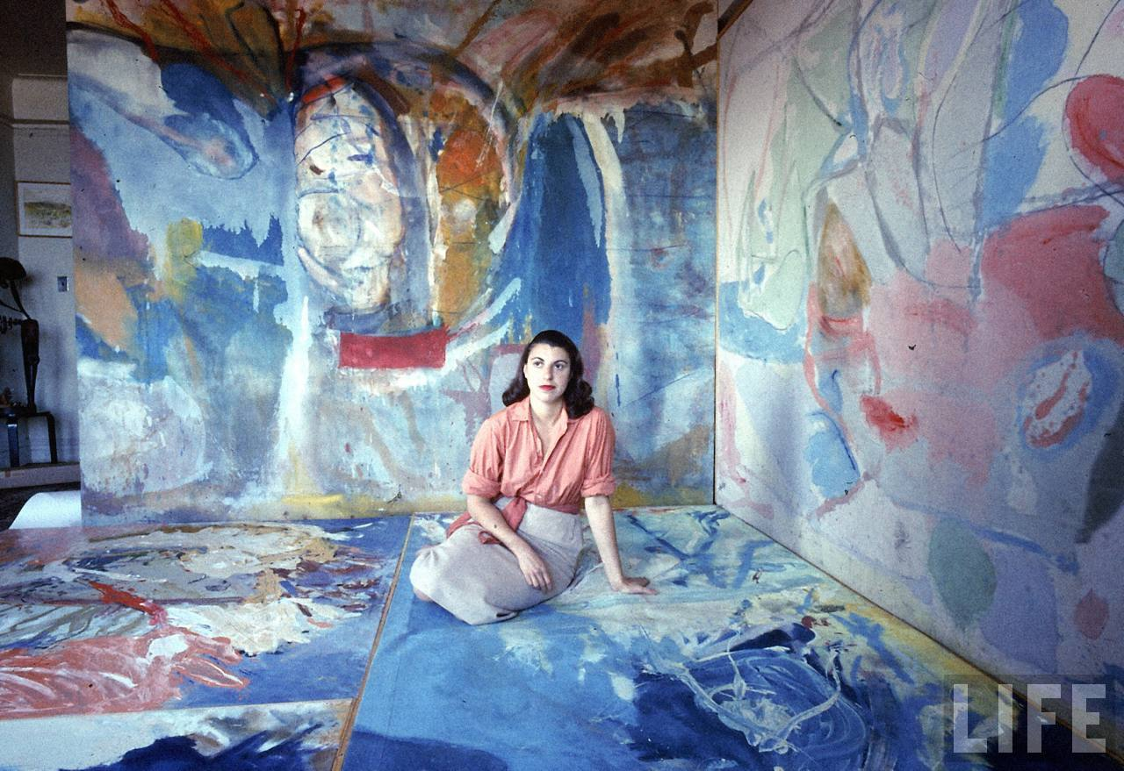
In the element of the ARTIST at work
What about art that is contained within the environment it was created, and not for public consumption at all? Artists usually belong to a lower status in our society however esteemed they have become in their field. Many artists create work that will never be seen by the public, yet participate in acts of production.

Slide 11
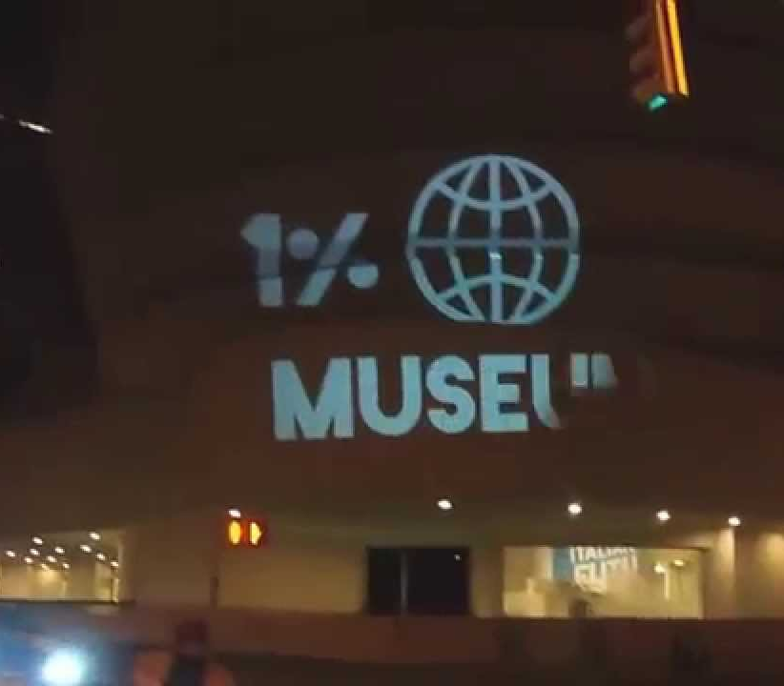
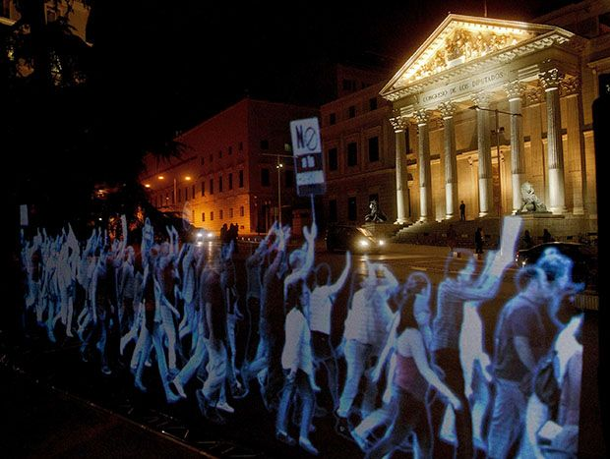
CONFLICT
PARADIGM
From the conflict perspective, looking at the institution of the art world it is easy to see how the use of cultural capital perpetuates class divides, inequities and disparities. It is the art world and its experts who define the dominant ideology of any given time, and what is high art or lowbrow proletariat meal. The art world also determines the worth of art, and who will actually be able to own art, what the rights of the artists may be and how accessible it will be to the public. Studies show that people in lower socioeconomic statuses are visiting museums at a lower percentage, thereby not accessing the educational or cultural benefits. The art world creates an esoteric lexicon for art to prevent the masses from being able to readily ‘read’ the art without the help of academia. Many people are rejecting this and protesting this as well as other exploitative museum practices.

Slide 12
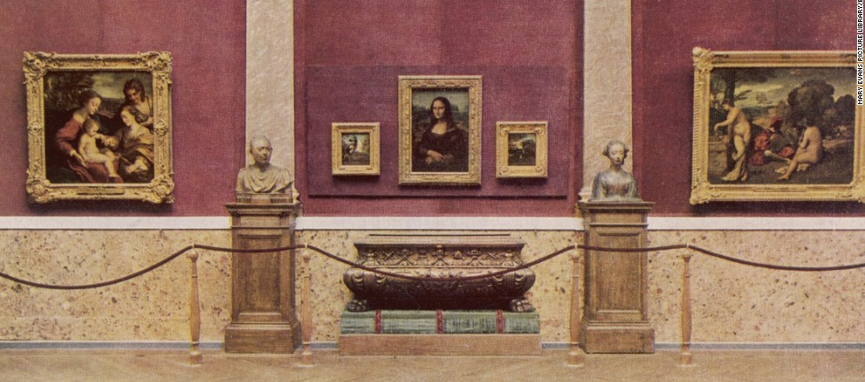
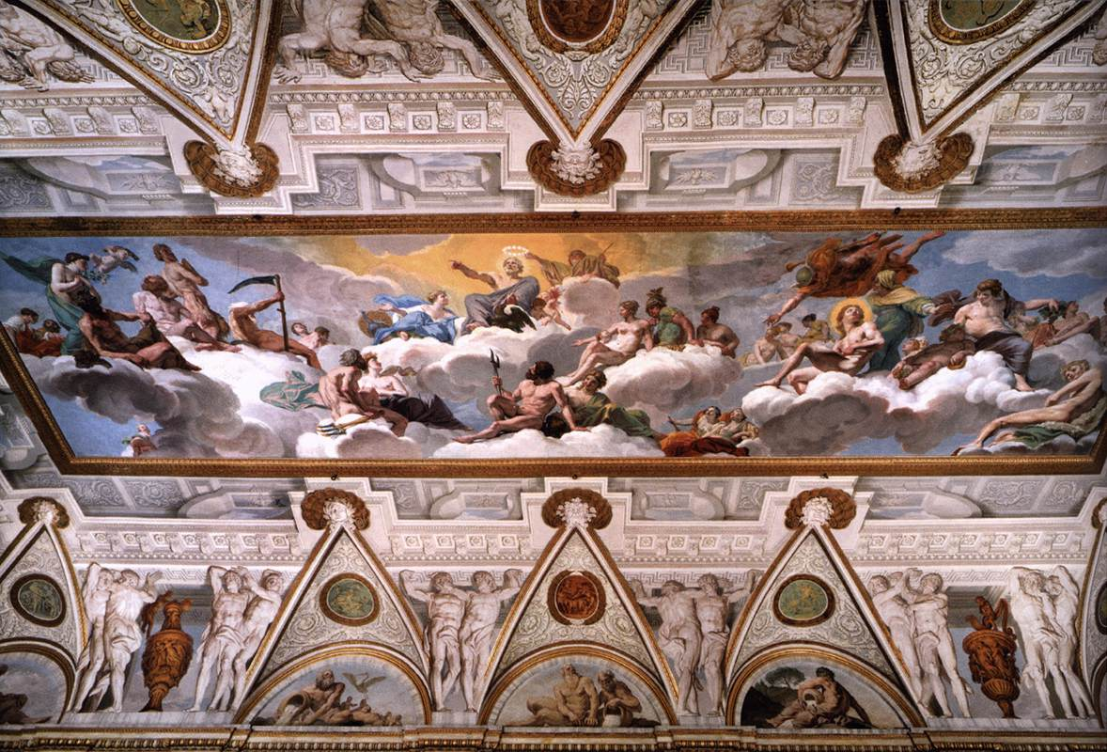
Art separated by the proverbial and literal velvet rope

Slide 13
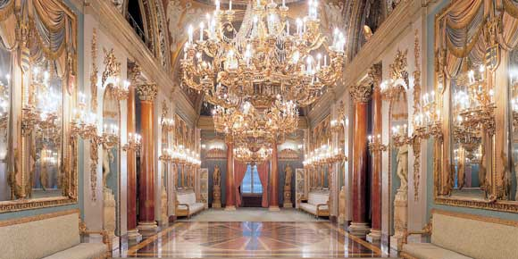
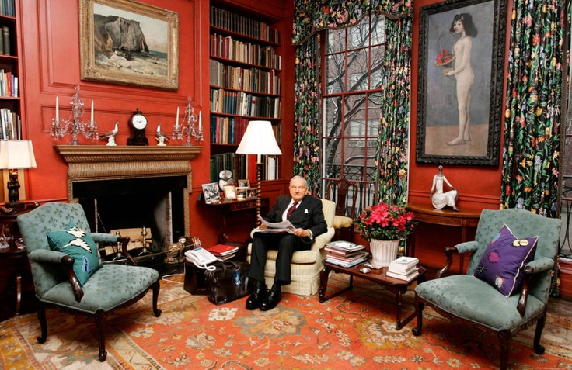
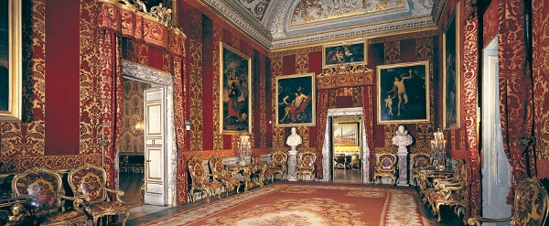
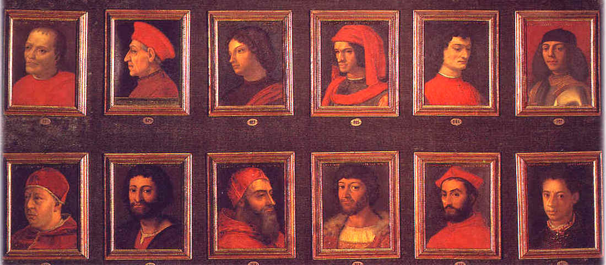
The wealthy founders and funders of museums are like extensions of the patronage system; the Medicis and Borgheses are the Rockefellers and Ahmansons now. They may view themselves and many call them cultured philanthropists, but others see them as the forces behind the institution using it for social control perpetuation of wealth, cultural capital and status of the elite. These images are from their homes.

Slide 14
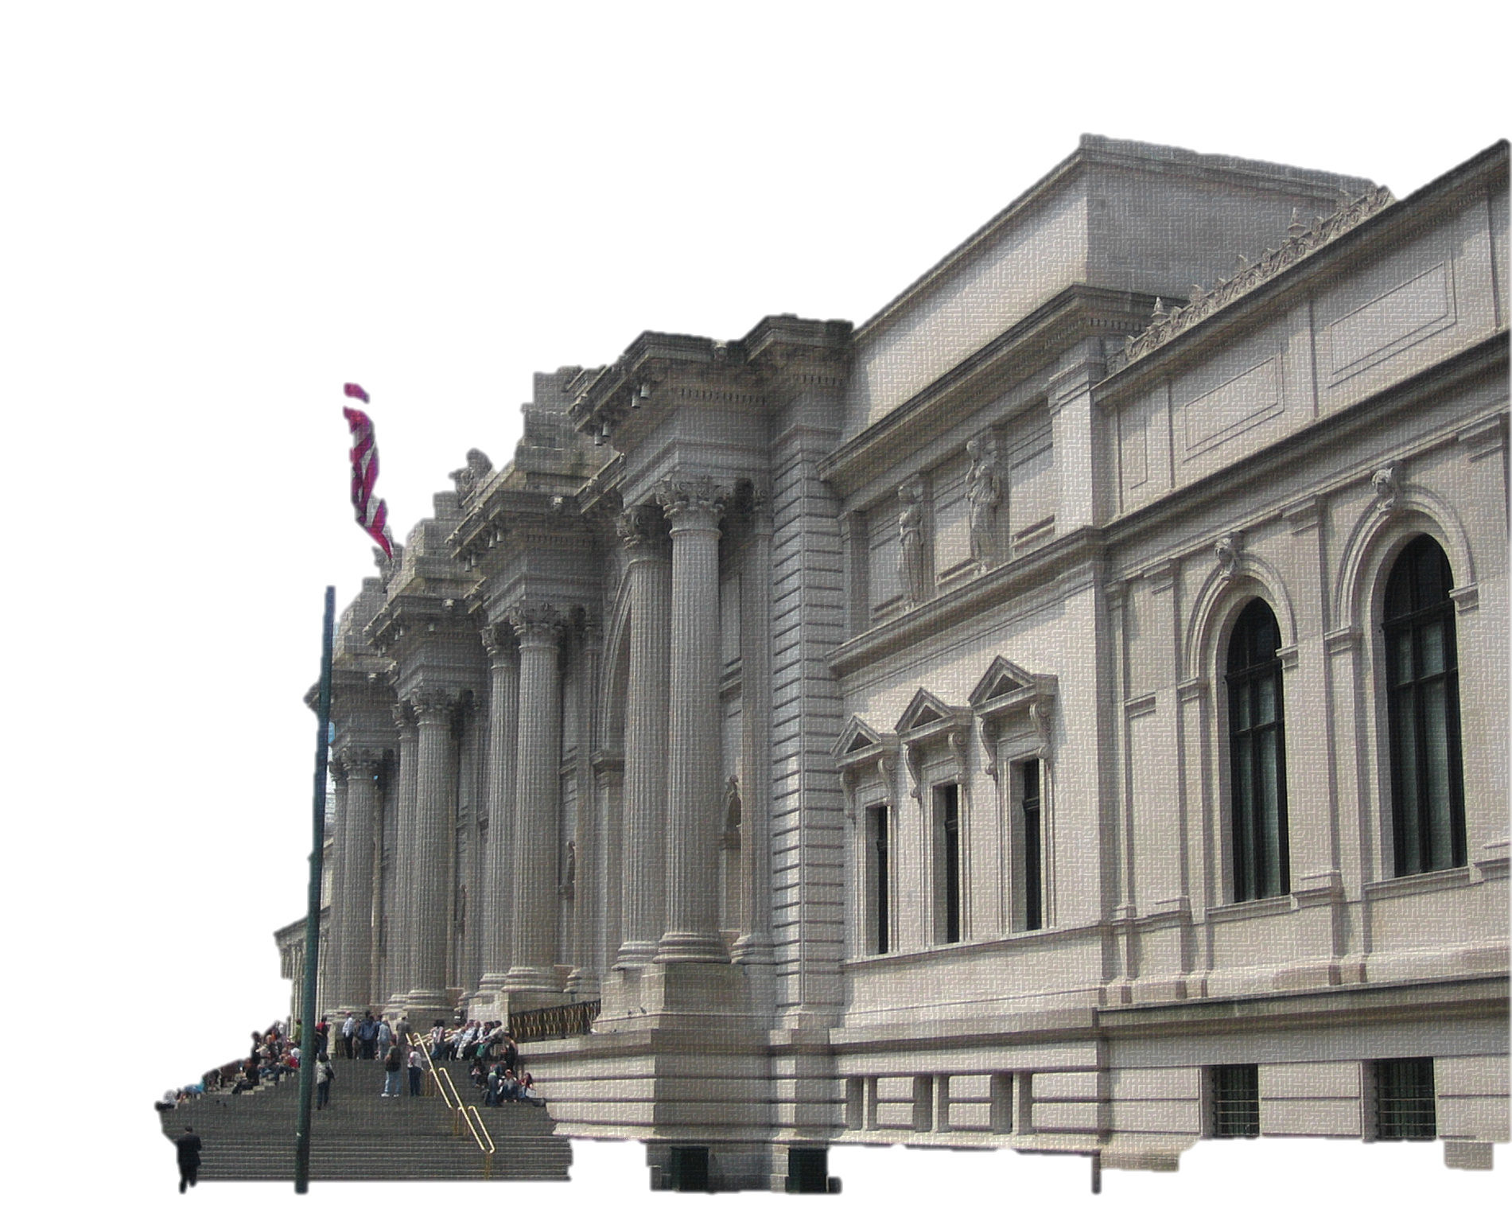
Some museums, like the Metropolitan Museum of Art offer interactive programs to reach a diverse group of viewers. This is one way to improve the experience and perception of public museums, being sure to serve all equally, not just people with the cultural capital and influences to access to high art.

Slide 15
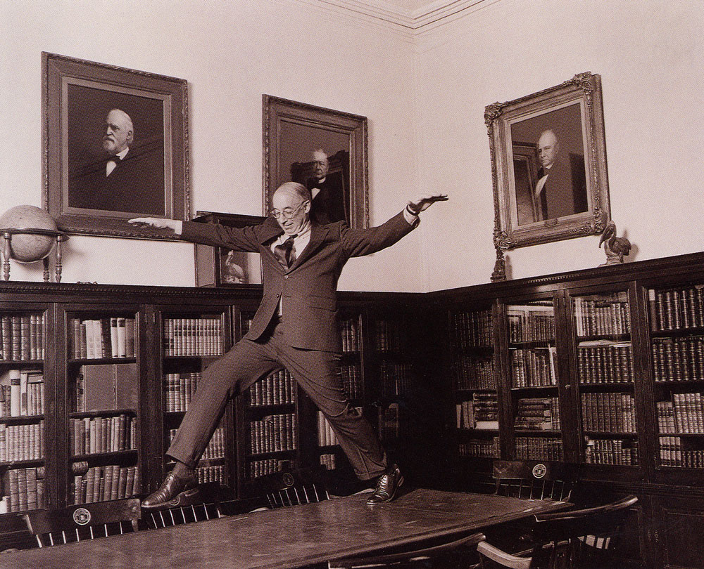
The institution of art does not have to be stuffy elitist snobbery, the aesthetic joy should be shared by all!

Slide 16
Works Cited:
Wood, Paul. Modernism in Dispute: Art since the Forties. New Haven: Yale UP, in Association with the Open U, London, 1993. Print.
Janson, H. W., and Penelope J. E. Davies. Janson's History of Art: The Western Tradition. 7th ed. Upper Saddle River, N.J.: Pearson Prentice Hall, 2007. Print.
Wartenberg, Thomas E. The Nature of Art: An Anthology. Fort Worth: Harcourt College, 2002. Print.
"Libraries and Study Centers." Http://www.metmuseum.org/research/libraries-and-study-centers. The Metropolitan Museum of Art. Web. 27 Nov. 2015.
Estrada, Andrea. "Art for the Masses." Http://universityofcalifornia.edu/news/origins-public-art-museum. The Regents of the University of California, 24 July 2014. Web. 28 Nov. 2015.
Lewis, Geoffrey D. "History of Museums." Http://www.britannica.com/topic/history-398827. Enclyclopedia Britannica, 2015. Web. 28 Nov. 2015.
Dequier, A. "From Palace to Museum, 800 Years of History." Http://www.louvre.fr/en/routes/palace-museum. Musée Du Louvre, 2015. Web. 28 Nov. 2015.
Https://www.arts.gov/sites/default/files/NEA-Research-Report-23.pdf. Web. 2 Dec. 2015.

